Slide 1

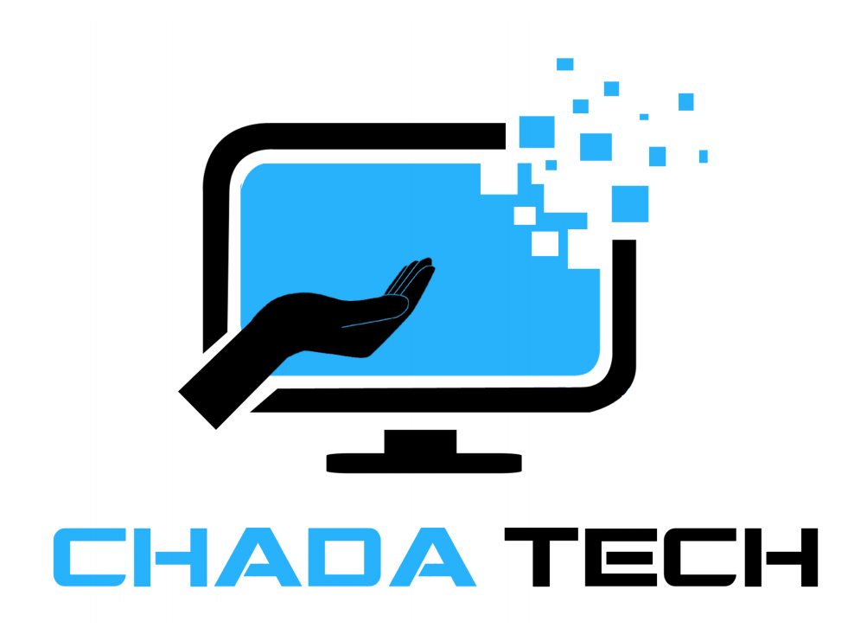
Scrum-Agile vs. Waterfall
Presentation by:
Mustafa Alsouqi

Slide 2

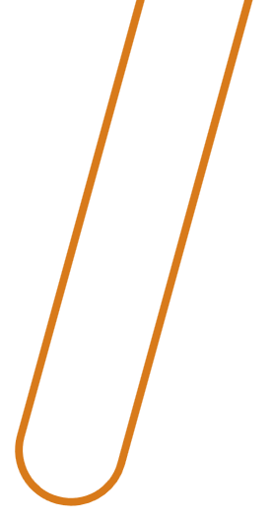
What is Scrum-Agile?
Agile is an iterative, flexible approach focused on continuous delivery and client feedback.
Scrum is a popular Agile framework with defined roles and phases.
Benefits of Scrum-Agile: Faster feedback loops, adaptability, and collaboration.

Slide 3

Key Scrum-Agile Roles
Product Owner: Represents stakeholders, prioritizes the backlog, ensures value delivery.
Scrum Master: Facilitates the process, removes obstacles, ensures team follows Scrum principles.
Development Team: Cross-functional group responsible for delivering the product incrementally.

Slide 4

Scrum Agile Phases in SDLC
Sprint Planning: Define the work to be completed in the sprint.
Development: The team works on product features based on prioritized user stories.
Daily Stand-ups: Short daily meetings to discuss progress and blockers.
Sprint Review: Team demonstrates the work completed to stakeholders.
Sprint Retrospective: Team reflects on what went well and areas for improvement.

Slide 5
What is the Waterfall Model?
Waterfall is a linear, sequential development model.
Each phase (requirements, design, implementation, testing, deployment) must be completed before moving to the next.
Little flexibility for changes once a phase is complete.

Slide 6
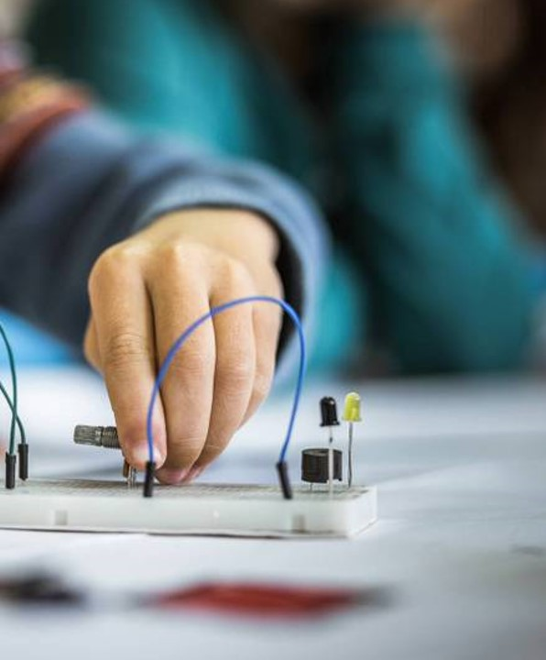
Agile vs. Waterfall: A Practical Comparison
Flexibility: Agile allows for changes at any point, while Waterfall locks in requirements early.
Feedback: Agile incorporates feedback throughout development, Waterfall typically waits until the end.
Time to Market: Agile delivers working features sooner, while Waterfall delivers the entire product at the end.
Example from SNHU Travel project: Feedback from focus groups would have been harder to incorporate with Waterfall.

Slide 7

Waterfall or Agile: How to Choose
Project Complexity: Agile is better for complex, evolving projects with frequent changes. Waterfall is suitable for projects with clearly defined requirements.
Client Involvement: Agile works best when clients are involved throughout the development. Waterfall suits projects with less client involvement.
Timeline: If the project requires quick delivery of features, Agile is preferred. Waterfall works for projects with longer timelines.
SNHU Travel Project: Agile allowed us to adjust quickly based on user feedback, which would’ve been harder in Waterfall.

Slide 8

Conclusion: Why Scrum Agile?
Agile’s iterative process promotes adaptability, feedback, and collaboration.
Scrum-Agile enables teams to deliver working software faster and respond to changes more efficiently than Waterfall.
Based on the SNHU Travel project, Agile was the best fit for ensuring flexibility and stakeholder satisfaction.

Slide 9

Thank you

Slide 10
References
Beck, K., Beedle, M., van Bennekum, A., Cockburn, A., Cunningham, W., Fowler, M., ... & Thomas, D. (2001). Manifesto for Agile Software Development. Retrieved from https://agilemanifesto.org
Schwaber, K., & Sutherland, J. (2020). The Scrum Guide: The Definitive Guide to Scrum. Scrum.org. Retrieved from https://scrumguides.org
Sommerville, I. (2016). Software Engineering (10th ed.). Pearson Education.
Royce, W. W. (1970). Managing the Development of Large Software Systems. Proceedings of IEEE WESCON, 1–9.
Rubin, K. S. (2013). Essential Scrum: A Practical Guide to the Most Popular Agile Process. Addison-Wesley.

